Slide 1

Missing Child Identification Using LBPH and Open CV
by
K. Vyshnavi
Roll No. 204G1A05C4
M. Srikanth Reddy
Roll No. 204G1A05A2
Y. Rajya Lakshmi
Roll No. 204G1A0577
P. Lakshmi Prasanna
Roll No. 194G5A0514
Under the guidance of
Dr. T.Venkata Naga Jayudu M.Tech., Ph.D
Associate Professor
Department of Computer Science and Engineering
Srinivasa Ramanujan Institute of Technology
(Autonomus)
2023 - 2024

Slide 2

Contents
Abstract
Introduction
Literature Survey
Existing System
Proposed System
Planning and Design
Implementation
Research Paper
Conclusion
References

Slide 3
Abstract
India struggles with numerous missing children every year, and many children remain untraced. To address this issue, the proposed system would assist the police and the public by expediting the process of searching using face recognition. When a child goes missing, the parent login into portal and can upload the latest picture and details of the child. When the case is registered and he/she get stores in the database. The footage of the cameras be used to recognize the pre-trained missing child with the help of Local Binary Patterns Histogram (LBPH) face recognition.
In this project, a web-based automated facial recognition system was developed, which is linked with backend machine learning technology to create a database for missing children. Furthermore, the system can detect both frontal and lateral faces. If matching is found, then it will send an alert email to the authorities.
Keywords: Missing Child, LBPH, Face recognition.

Slide 4
Introduction
Children are the greatest asset of each nation. The future of any country depends upon the right upbringing of its children. India is the second populous country in the world and children represent a significant percentage of total population. But unfortunately a large number of children go missing every year in India due to various reasons including abduction or kidnapping, run-away children, trafficked children and lost children.
As per the National Crime Records Bureau (NCRB) report which was cited by the Ministry of Home Affairs (MHA) in the Parliament, more than one seventy thousand children (77,535 in actual numbers) were reported to have gone missing till 2021, and 701 of them remained untraced till the end of the year.
So we are developing an effective solution to address this issue as Missing Child Identification Using LBPH and OpenCV. It will be useful for the police department to locate the missing children using facial recognition techniques.

Slide 5
Problem Statement
In India, to locate missing children, the police department uses manual searching processes that are time-consuming, inefficient, and resource-intensive, often stretching over extended periods and sometimes lasting for years. To expedite the process and improve efficiency, there is a pressing need for a more effective solution harnessing the power of technology.
To overcome this, the proposed system offers a systematic and technological solution that leverages facial recognition algorithms, such as Local Binary Pattern Histograms (LBPH), and integrates them into a user-friendly platform. This system would facilitate the efficient identification of missing children by automating the recognition process and enabling matching with a centralized database of facial images.

Slide 6
Literature survey
[1] V. Martsenyuk, O. Bychkov, K. Merkulova, and Y. J. I. A. Zhabska, have proposed an exploring Image Unified Space for Improving Information Technology for Person Identification.
Algorithms used:
Anisotropic diffusion for image processing.
Gabor wavelet transformation for image manipulation.
But the system still struggle with extreme conditions such as low-resolution images, occlusions, or variations in lighting, posing a limitation to its robustness in practical applications.

Slide 7
Literature survey
[2] M. Sowmya, K. Chaudhary, R. Soumya, and P. Panjiyar, An Ai-Assisted Search For Missing Children, According to (NCRB) figures provided by the Ministry of Home Affairs (MHA) in Parliament a total of 1,11,569 children were reported missing up until 2016, and 55,625 of them were remained missing at the end of year.
A GUI application was made in Python to aid the police open new cases and search for missing children as part of the AI-Assisted Search for Missing Children initiative.
[3] Ji Tao and Yap-Peng Tan, proposed a novel approach to automatic detection and clustering of human faces presented in videos.
Algorithms used: FaceNet for face detection.
FaceNet produces accurate results under different poses, but it is inefficient under different facial expression.

Slide 8
Literature survey
[4] Sandeep Mishra, Anupam Dubey, outline a survey on various techniques used for face recognition, which is one of the most widely used applications of image analysis and understanding. Face recognition system involves three main steps: face detection, feature extraction, and face recognition and also discusses the challenges and issues related to face recognition, such as illumination and pose variations, and provides a brief overview of some representative methods.
[5] Sisi Li, Zhonghua Liu, Di Wu, Hua Huo and Haijun Wang, have proposed a Low-resolution face recognition based on feature-mapping face hallucination.
Algorithms used: Convolutional Neural Network.
It is effective under different lightenings and poses, but it is difficult to recognize the face facial expression with low lightening.

Slide 9
Existing System
In India, the police department plays a pivotal role in preventing crimes such as kidnappings and maintaining law and order across the country. However, a significant issue within the Indian police force is their reliance on traditional manual processes for record-keeping and analysis of missing children. These methods include physically searching for missing children throughout the city, which can be extremely time-consuming.
To expedite the process and enhance efficiency, there is a pressing need for a more effective solution harnessing the power of technology.
Disadvantages:
Time consuming
Resource-intensive
Producing incorrect results

Slide 10
Proposed System
To overcome the difficulties of existing system, the proposed system offers a systematic and technological solution that leverages facial recognition algorithm and integrates them into a user-friendly platform. This system would facilitate the efficient identification of missing children by automating the recognition process and enabling matching with a centralized database of facial images.
By using Algorithms are:
Local Binary Pattern Histograms(LBPH)
Haar cascade classifier
Advantages:
Facilitate accurate identification under different conditions
Improves scalability

Slide 11
Planning
Requirements:
Hardware Requirements:
Processor : i5/Intel Processor
RAM : 8GB
Hard Disk : 128GB
Software Requirements:
Operating System : Windows OS 7+
Programming Language : Python 3.8
IDE : Visual Studio 1.87.0
Libraries used : cv2, Numpy, Pandas, smtplib.

Slide 12
Planning
Functional Requirements
To provide an authentication for the admin to login and access to the missing child Identification system.
To provide an alert email notification to the police authorities as soon as the missing child is identified.
Non Functional Requirements
1. Integrity: This Project allows only admin to login and add the missing child details into
the missing child identification system.
2. Security: This Project provides security to the database by which it can be accessed by
admin.
3. User-friendly model

Slide 13
Planning
Software Methodology: Agile Model
This project uses Agile methodology. In that we use scrum agile methodology.
Scrum is characterized by cycles or stages of development, known as sprints.
It has four stages: Planning, Implementation, Testing and review.
Advantages:
This Methodology has ability to change and adapt with and satisfy the changing needs in
short term.
Requires less documentation.

Slide 14
Planning
Objectives:
The project aims to improve speed, efficiency and accuracy of the missing children location process without using the traditional methods, implementing an user interface with email mechanism that will inform the authorities as soon as they are detected, enable rapid response and reunification of missing children with their families.
Scope:
To detect and recognize the child faces using webcam.
The face recognition system take only one frame at a time and in that which will detect multiple human faces.
Performance:
We are going to recognize the child faces accurately under different conditions.

Slide 15
Planning
Time Estimation:
SI.No | Activity | Duration
1 | Domain Selection | 1 Week
2 | Literature survey and problem definition | 2 Week
3 | Planning and Designing | 2 Week
4 | Data collection and Data pre processing | 1 Week
5 | Developing the code | 2 Week
6 | Implementing the model | 2 Week
7 | Validating and comparing model | 2 Week

Slide 16
Planning
MODULES
User module: Here, admin will be the user who is responsible for accessing and managing
the Missing Child Identification system.
Admin login: Admin login into the portal using login credentials.
Missing child details: Admin will add the missing child details(child name,
parent contact number, address and image).
Police station details: Admin will add the police station details into the portal.
Access to facial recognition system: After adding the details the admin will access
to the facial recognition system.
Automatic Alert email: If the child is identified then automatically alert email is
send to the police authorities.

Slide 17
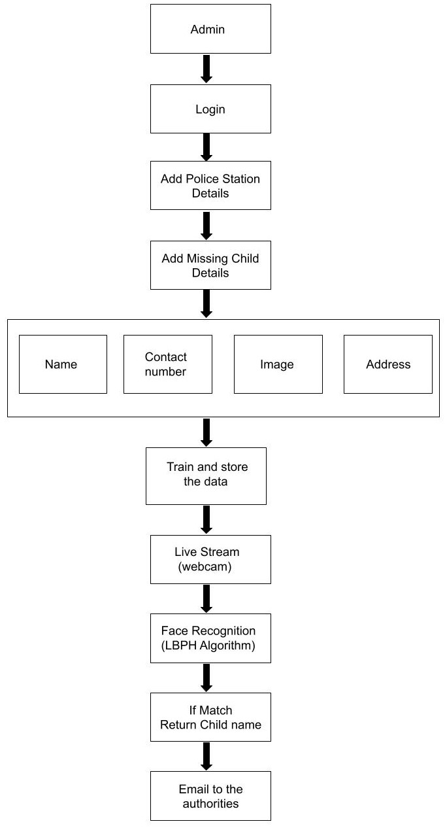
Design
Block diagram of User module

Slide 18
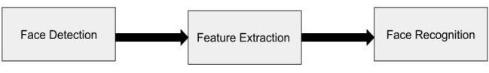
Planning
System module: This module is responsible for missing child identification.
User Authentication: It ensures only authorized users(admin) access the system it includes
login screens and password verifications
Data management: Missing child images are stored with child ID securely in the database.
Facial Recognition: Face Recognition system is responsible for processing and identifying faces from the live stream input of faces from a webcam.
Face recognition system involves mainly 3 steps:
Face Recognition System

Slide 19
Planning
1. Face Detection: In this step, if a face is detected in the frame, it will draw a rectangular box around it.
2. Feature Extraction: Utilizes algorithms like LBPH to extract and analyze facial features from the uploaded images.
3. Face Recognition/Matching: Compares features from new or incoming faces detected in a live stream of a webcam with the database of missing children to identify potential matches.
Automatic Email Alert Generation and Management: It will send notifications through email to relevant authorities (like police stations) when the system identifies a potential match.

Slide 20
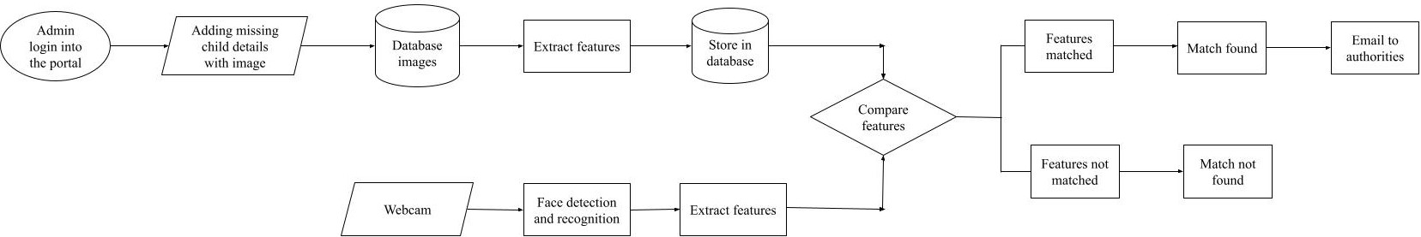
Design
Proposed Missing child Identification System

Slide 21
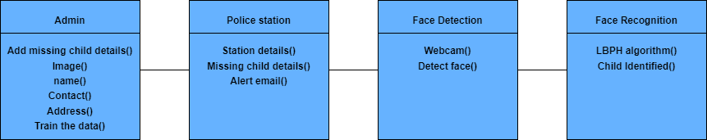
Design
Proposed System Class Diagram

Slide 22
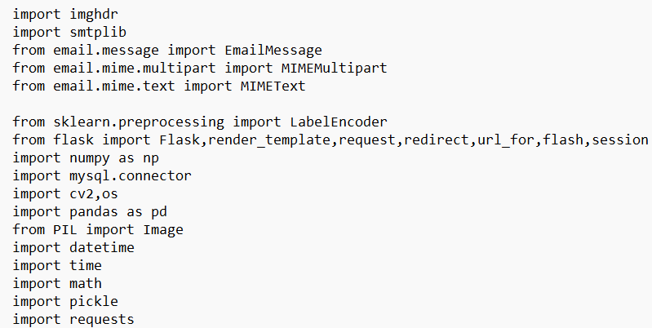
Implementation
Frontend: Web page using HTML, CSS, Bootstrap
Backend: Using OpenCV and LBPH algorithm
Importing necessary libraries:

Slide 23
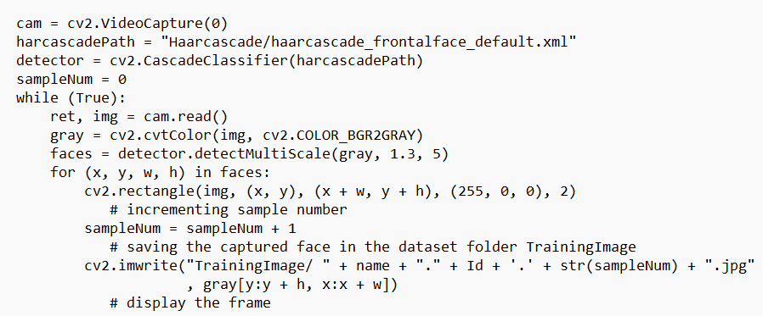
Implementation
Face Detection Using Haar cascade classifier

Slide 24
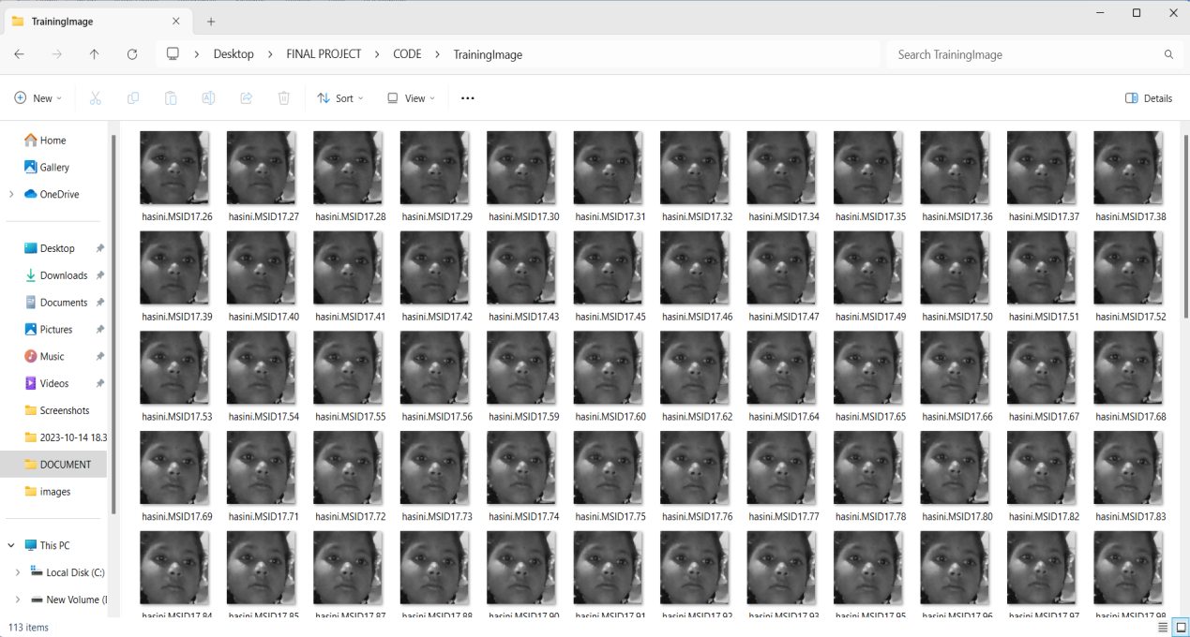
Implementation
Captured Images at the time of Adding Missing Child details

Slide 25
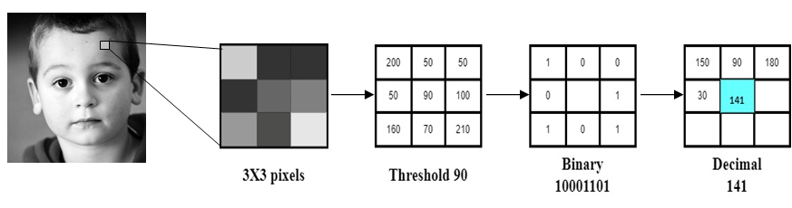
Implementation
Face Recognition: Working of Local Binary Pattern Histogram Algorithm
Feature extraction using LBPH algorithm:
Following are the steps:
Local Binary Pattern Transformation:
1, if x > cenval
0, Otherwise
f(x) =
Local Binary Pattern operator

Slide 26
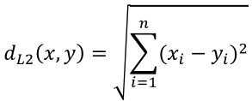
Implementation
Histograms computation
Concatenation of Histograms
Recognition and Matching Process: Input faces from a live stream through a webcam undergo preprocessing and feature extraction, followed by comparison with database histograms using Euclidean distance for finding closest matches.
Where, x is a histogram1
y is a histogram2.

Slide 27
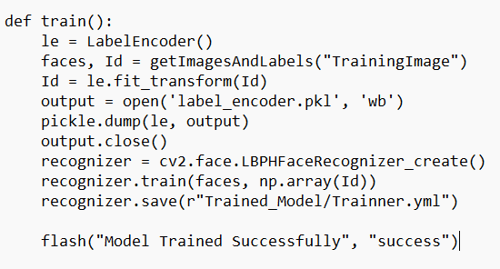
Implementation
Model Training using LBPH Algorithm

Slide 28
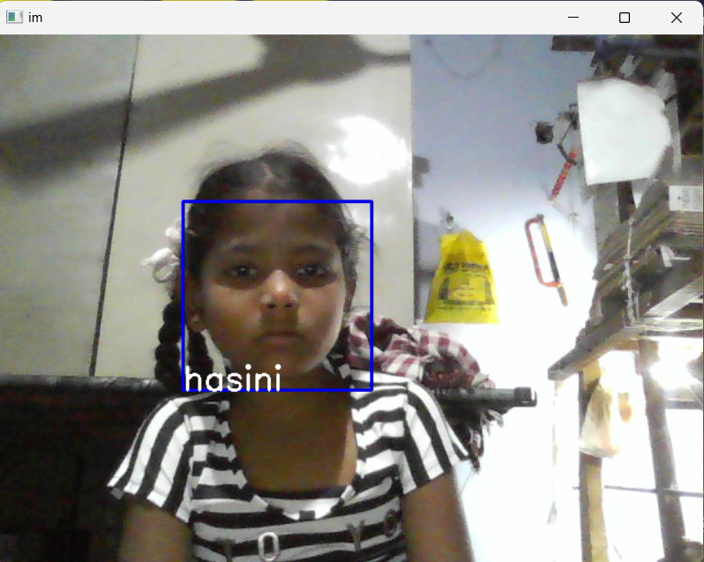
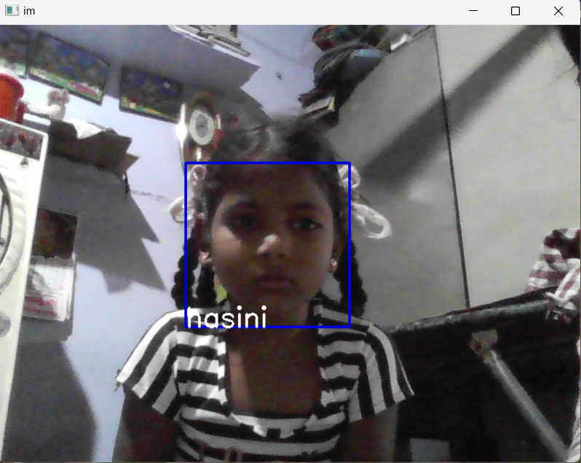
Implementation
Recognizing child face in lightening
Recognizing child face in poor lightening

Slide 29
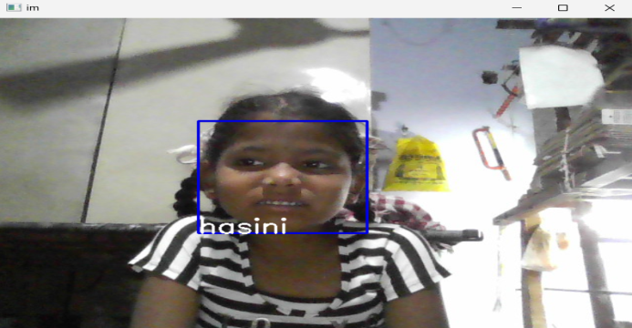
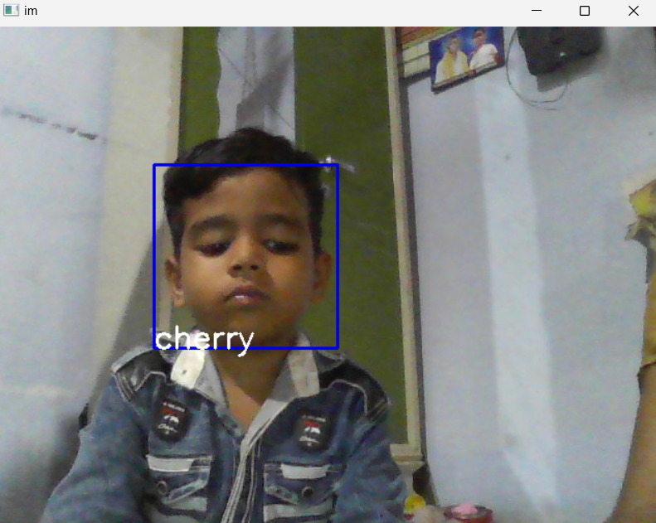
Implementation
Recognizing child face when facial expression is
Happy
Recognizing child face when facial expression is
Sad

Slide 30
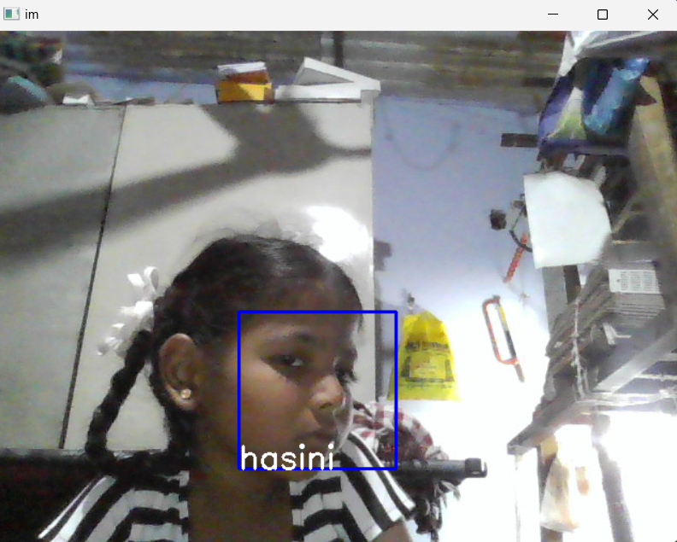
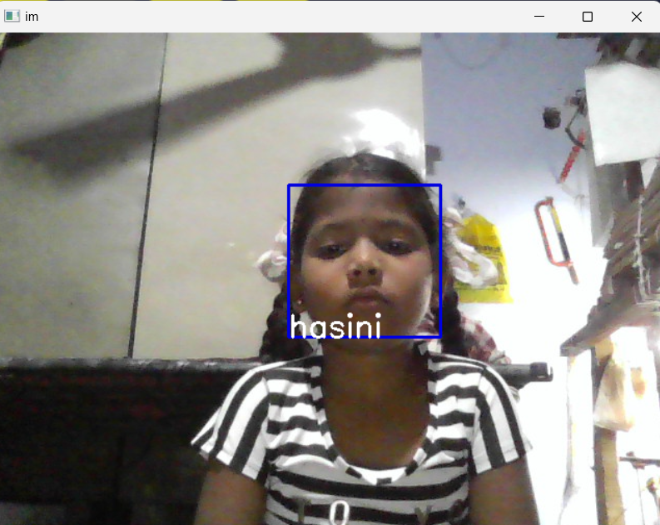
Implementation
Recognizing child face in Side View
Recognizing the child when face is Up

Slide 31
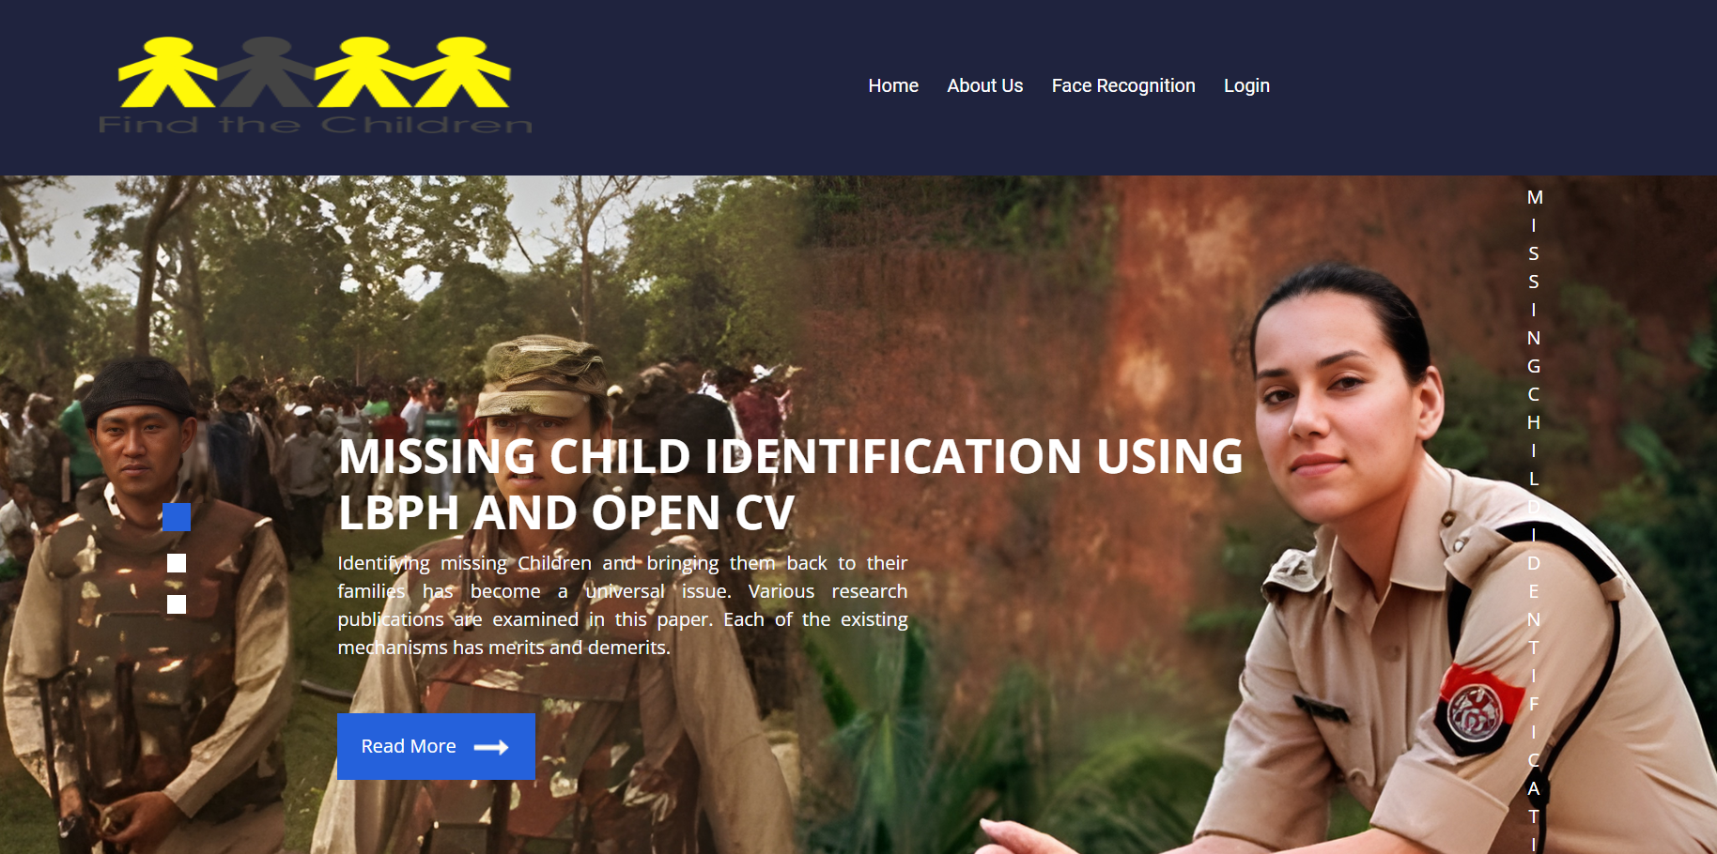
Implementation
Home Page

Slide 32


Implementation
Admin Login Page
Admin Home Page

Slide 33

Implementation
Adding Police station details

Slide 34

Implementation
Add and Train the Missing child details

Slide 35
Implementation
Facial Recognition and matching the Missing child

Slide 36
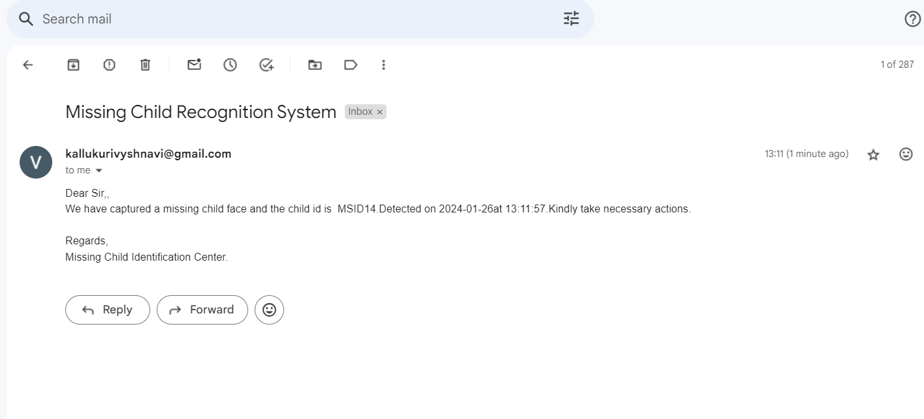
Implementation
Alert Email notification

Slide 37
Research Paper
Research Paper

Slide 38
Conclusion
The project aims to address the issue of missing children by utilizing facial recognition technologies, specifically Local Binary Pattern Histograms (LBPH). The system, which combines image processing techniques and deep learning, has shown potential for enhancing the speed and accuracy of identifying missing children. Its success in accurately matching children's faces under different conditions demonstrates in tackling real-world challenges. The project also emphasizes the importance of ethical considerations and privacy in the deployment of facial recognition technology. The collaborative approach, involving authorities like police departments and administrative personnel, ensures the system is adaptable and user-friendly. This project represents hope for child safety and welfare, highlighting the potential of facial recognition technology for societal impact.

Slide 39
References
[1]. V. Martsenyuk, O. Bychkov, K. Merkulova, and Y. J. I. A. Zhabska, "Exploring Image
Unified Space for Improving Information Technology for Person Identification”, July 2023.
[2]. M. Sowmya, K. Chaudhary, R. Soumya, and P. Panjiyar, "AI-Assisted Search for Missing
Children", in IEEE 2nd Mysore Sub Section International Conference 2022, pp. 1-6: IEEE.
[3]. Ji Tao and Yap-Peng Tan, “Face Clustering in Videos using Constraint propagation”, June
2008 in IEEE International Symposium on Circuits and Systems (ISCAS).
[4]. Sandeep Mishra, Anupam Dubey “Face Recognition Approaches: A Survey”,
International Journal of Computing and Business Research (IJCBR),vol.6, pp.1, Jan 2
January. 2015.
[5]. Sisi Li, Zhonghua Liu, Di Wu, Hua Huo and Haijun Wang, “Low-resolution face
recognition based on feature-mapping face hallucination", vol. 101, p. 108136, 2022.

Slide 40
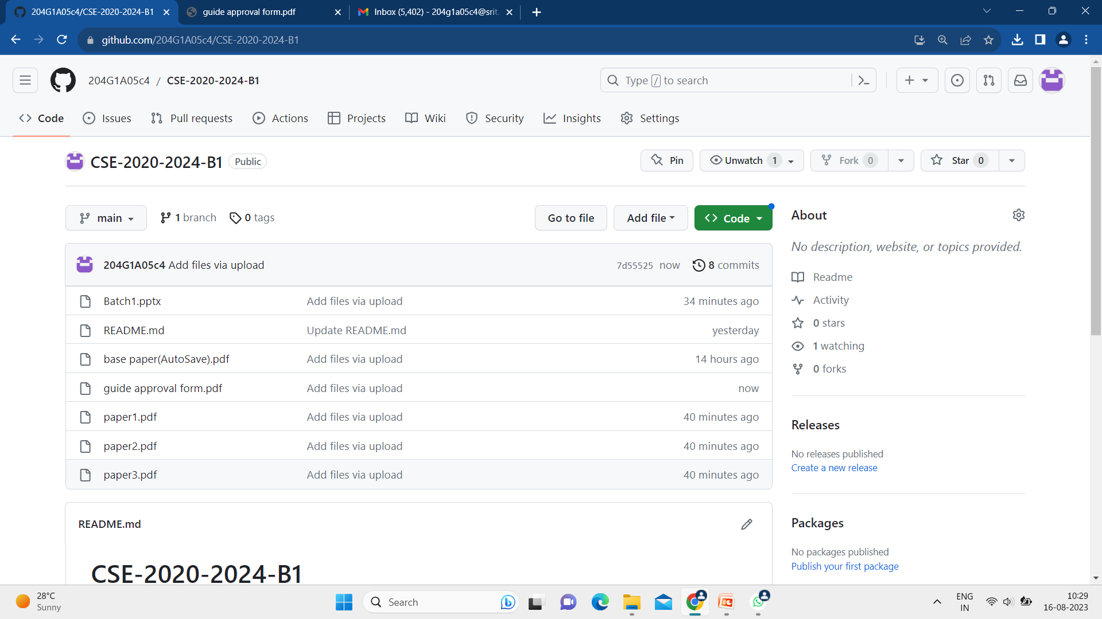
Git Hub Dashboards of each student
Github Link: https://github.com/204G1A05c4/CSE-2020-2024-B1.git

Slide 41
Thank You!!!

